Slide 1
How To Retire Early Making Accelerated Coal Phaseout Feasible and Just
Uday Varadarajan
Fellow, Stanford SFI and Principal, RMI
uvaradarajan@rmi.org
4 March 2021

Slide 2
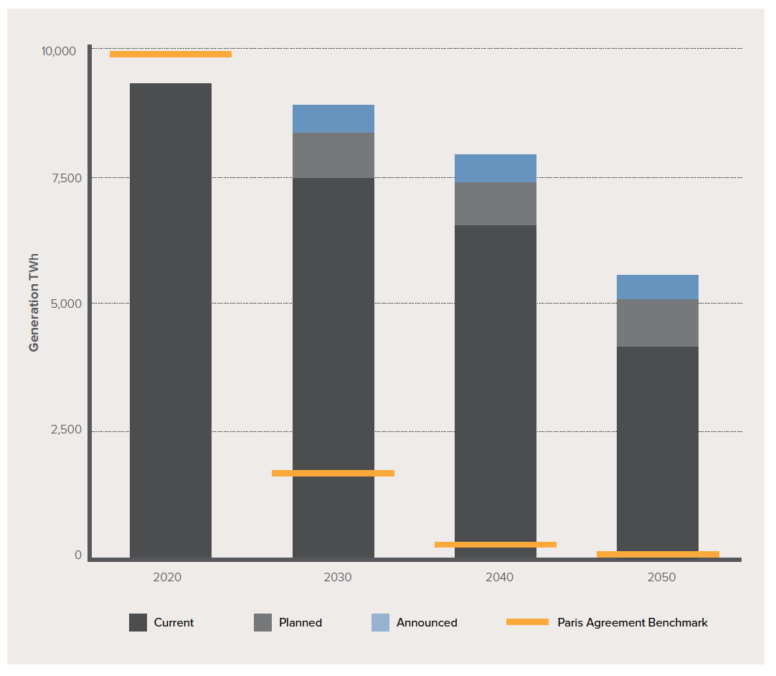
Phasing out OECD coal use by 2030, and non-OECD coal by 2040, is critical to alignment with a 1.5C future
World’s Coal-Based Power Generation Incompatible with Paris Agreement Benchmarks
Chart taken, with permission, from Paola A. Yanguas Parra, Gaurav Ganti, Robert Brecha, Bill Hare, Michiel Schaeffer, and Ursula Fuentes, Global and Regional Coal Phase-out Requirements of the Paris Agreement: Insights from the IPCC Special Report on 1.5°C (Climate Analytics, 2019)

Slide 3
The economics are increasingly favorable – 39% of coal generating capacity globally today – rising to 78% by 2025 – can’t compete with renewables and storage
Source: How to Retire Early, RMI, Carbon Tracker, Sierra Club

Slide 4
But globally, customers are locked-in to paying for 93% of coal generation – meaning coal stranding risk is shared with or fully borne by coal workers, communities, and customers
Regulated Tariff/
Government
Owned
10-25
Years
(PPA)
Contractual Lock-In
Regulatory / Political Lock-In
Source: How to Retire Early, RMI, Carbon Tracker, Sierra Club

Slide 5
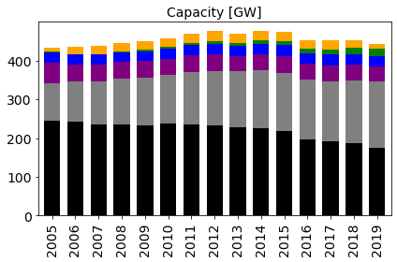
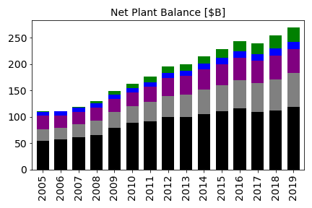
Example: US regulated utilities (IOUs*) have retired some of their oldest coal assets, but they’ve doubled down on investing in their remaining coal fleet over the last decade
Steam
Other Fossil
Nuclear
Hydro
Other RE
EE & DR
*Charts assess FERC Form 1 reporting utilities, which are mostly regulated IOUs.

Slide 6
So even though US utility coal phaseout looks economic and risk-reducing in the long-run, in the near-term, utilities, customers, and communities face real transition risks from rapid coal phaseout
Customers
Utilities
Communities
Challenge | Near-term rate shock | Rate base and earnings erosion | Jobs and tax revenue losses
Jeffrey Energy Center Unit 1 | ~$60 million per year in post-retirement coal capital costs for 21 years | $620 million in unrecovered costs | ~230 employees, ~$15 million per year in salaries at risk

Slide 7
Rapid phaseout requires a strategy to mitigate customer and community transition risks and bring coal owners to the table: A Three-Part Coal (Re)financing Strategy can do this

Slide 8
Example: US regulated utility ratepayer-backed bond securitization

Slide 9
Example: US regulated utility ratepayer-backed bond securitization
Customers
Utilities
Communities
Challenge | Near-term rate shock | Rate base and earnings erosion | Jobs and tax revenue losses
Jeffrey Energy Center Unit 1 | ~$60 million per year in post-retirement coal capital costs for 21 years | $620 million in unrecovered costs | ~230 employees, ~$15 million per year in salaries at risk
Solution | >$25 million savings annually relative to BAU with securitization and renewables with storage | Reinvestment of capital in clean energy can be earnings accretive | Finance ~$35 million in transition assistance via refinancing

Slide 10
US IOUs are proof of concept – implementation globally requires innovation to adapt the model to address key design considerations
Key Design Considerations | Description
Ownership Structures | Securitization is adapted to investor-owned utilities – other ownership models, such as municipal or state-owned, may not benefit as much from refinancing alone
Power Contract / Tariff Structures | Contracted assets or assets with tariffs that do not necessarily provide full cost recovery may require different refinancing tools (i.e. asset-backed securitization)
Fuel Supply Contracts | Long-term fuel supply contracts may shift asset value to the fuel supply provider, requiring solutions that bring the mine operator to the table
Economic Competitiveness | Many emerging economies are still years away from renewable + storage competitiveness – concessionary finance may be required (i.e., carbon financing)
Utility / National Financial Conditions | Securitization cannot work in countries without well-developed public debt markets in the absence international support (i.e., development financing institutions)
Demand Growth | Solutions may need to be adapted to accommodate growing demand that may favor capacity retention (i.e., gradual coal redevelopment / phaseout plans)

Slide 11
Backup Slides
Uday Varadarajan
Fellow, Stanford SFI and Principal, RMI
February 5, 2021

Slide 12
Over $1.5 billion in four coal phaseout securitization transactions have been authorized or completed to date
Utility | Consumers Energy (2014 and 2020) | PNM (2020) | WEPCO (2020)
State | Michigan | New Mexico | Wisconsin
Issuance/Approved Amount/Date* | $378 million issued in 2014; $688 million approved in 2020 | $361 million approved in 2020 | $118 million approved in 2020, pending financing costs at the time of bond issuance
Use of Proceeds | Coal plant cost recovery | Coal plant cost recovery | Coal plant cost recovery (environmental control device cost only)
Rate Base Adjustment | Used bill credit for interim rate adjustment | Used bill credit for interim rate adjustment | No credit as the plant was already removed from the rate base
Transition Plan | Handled separately in the IRP settlement | $60 million in transition assistance included as qualified cost | No concrete commitment in either the financing order or the retirement settlement
Securitization Bond Tenor | 15 years for the 2014 bond; 8 years for the 2020 bond | 25 years | 13 years
Timing of Securitization and Retirement | 2014: securitize before retirement (2015); 2020: simultaneous securitization and retirement (2023) | Simultaneous securitization and retirement (2022) | Securitize (2021) after retirement (2018)
Timing of Replacement | Purchased the Jackson Gas Plant to partially replace the assets retired in 2015; 2019 IRP plans to add 550MW wind, 6,000 MW solar by 2040 to replace the rest of the retired coal. | Clean Energy Portfolio was authorized in 2020 and undergoing RFPs – total transaction is estimated to save customers $7/month on average | No concrete commitment in either the financing order or the retirement settlement

Slide 13
Variants: Single Asset Refinancing (PPA Asset)

Slide 14
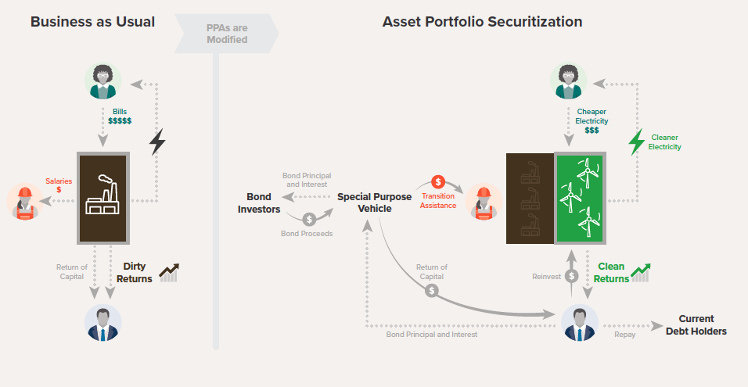
Variants: Asset Portfolio Securitization (PPA Asset Portfolio)

Slide 15
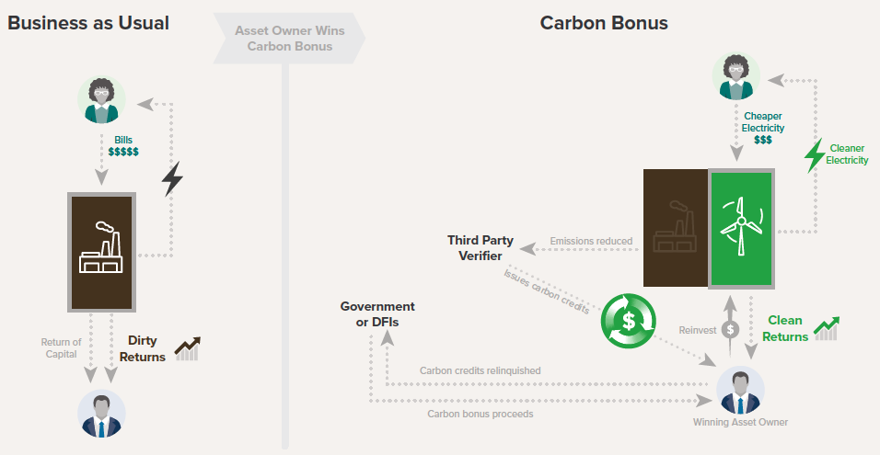
What about when the economics only works with a price on carbon? Carbon Bonus

Slide 16
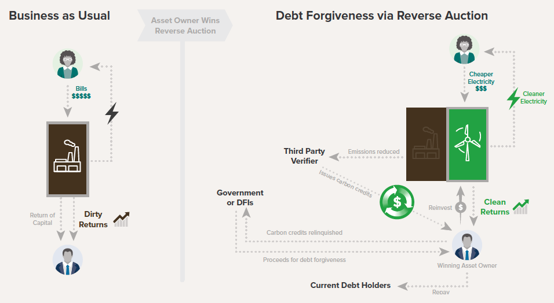
What about when the economics only works with a price on carbon? Debt Forgiveness via Reverse Auction + Carbon Bonus

Slide 17
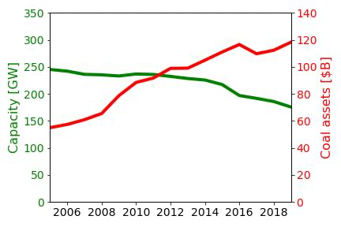
Example: IOU coal assets have on average $700m/GW in net book value today vs. $200m/GW in 2005 – with most of that investment during Obama years even with real threat of carbon regulation
Why did they do this?
Retirements were of plants that investors had recovered most or all their capital from
Remaining plants saw recent pollution control and efficiency investments authorized by state regulators
The state regulatory approval gives utilities a strong case for cost recovery on those investments
This significantly mitigates direct transition risk by shifting those risks and costs to customers and coal communities
*Charts assess FERC Form 1 reporting utilities, which are mostly regulated IOUs.

Slide 18
Example: US regulated utility ratepayer-backed bond securitization

Slide 19
Securitization mitigates rate shock by replacing utility equity and debt with low-cost debt repaid via dedicated surcharge

Slide 20
Utility reinvestment allows utility investors to replace returns from older assets with clean returns

Slide 21
Let’s return to the US regulated utility case – with traditional utility financing, customers face the prospect of rate shock with rapid coal phaseout
Rapid Amortization of Regulatory Asset
$82m
Old Plant Capital Costs
$55m
Still have to repay utility investment AND 8-10% return
Old Plant
Fuel and O&M Costs
$34m
Fuel and O&M costs of old plant go away with closure
New Plant Total Costs
$36m
Note: Illustrative example based on modeled results
Old Plant
New Plant with
Retired Asset Costs

Slide 22
Refinancing capital recovery and transition assistance with securitization – a bond repaid in rates – can help mitigate rate shock and finance community transition
Rapid Amortization of Regulatory Asset
$82m
Return of
Utility Capital
Old Plant Capital Costs
$55m
Still have to repay utility investment AND 8-10% return
Transition Assistance
Refinance with 3-4% bond
Securitization Costs $24m
Old Plant
Fuel and O&M Costs
$34m
Fuel and O&M costs of old plant go away with closure
New Plant Total Costs
$36m
New Plant Total Costs
$36m
Note: Illustrative example based on modeled results
Old Plant
New Plant with
Retired Asset Costs
New Plant with
Securitization

Slide 23
…and utility reinvestment in clean energy can allow utilities and their investors to contribute to the transition
Rapid Amortization of Regulatory Asset
$82m
Utilities can reinvest in clean energy to grow their earnings
Return of
Utility Capital
Old Plant Capital Costs
$55m
Still have to repay utility investment AND 8-10% return
Transition Assistance
Capital Recycling
Refinance with 3-4% bond
Securitization Costs $24m
Old Plant
Fuel and O&M Costs
$34m
Fuel and O&M costs of old plant go away with closure
New Plant Total Costs
$36m
New Plant Total Costs
$36m
Note: Illustrative example based on modeled results
Old Plant
New Plant with
Retired Asset Costs
New Plant with
Securitization

Slide 24
Securitization must first be enabled by legislation in regulated states that did not restructure - then utilities must use it with approval from regulators
Demand from stakeholders
Bill introduced in state legislature
Bill passes state legislature
Who is involved:
Customers
Utility
Advocates
State reps.
State senators
State reps.
State senators
Securitization is enabled in the state
Bonds issued to the market
Securitization request approved
Securitization request filed
Who is involved:
Securitization company
Regulator
Utility

Slide 25
New securitization legislation is gaining momentum across the country, with passage in three states (NM, MT, CO) in 2019, with many more likely this year
MT: HB 467 Passed in 2019
KS: HB 2691 Introduced in 2019, likely reintroduced in 2021
UT: FY 19 Interim Bill
Introduced in 2019; likely reintroduced in 2021
Note: NC legislation authorizes storm cost recovery; early plant retirement focused bill likely to be reintroduced
CO: SB 19-236 Passed in 2019
NC: SB 559 passed
SC: AB 110 Introduced in 2019
NM: SB 489 Passed in 2019
MO: HB 1703 Introduced in 2019; likely reintroduced in 2021
Legislation exists
Legislation introduced
Likely (re)introduced in 2021
Stakeholder interest

Slide 26
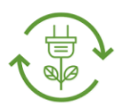
More generally, we need innovation in transition financing to monetize some of the long-term benefits of transition to mitigate transition costs and risks
Transition Finance
Public Treasury Financing
Central Bank Financing
Multilateral Bank Financing
Monetize Share of Future Benefits
Mitigate Transition Costs and Risks
Ratepayer-Backed Securitization
Corporate Green Bonds
Bundled Clean Energy Finance
Private Equity
Transition Costs and Risks
Long-Term Benefit Streams
Stranded Assets
Declining Utility Earnings
Financing Cost Savings
Clean Energy Incentives
Generation Cost Savings
Customer Price Spikes
Stranded Workers
Stranded Communities
Local Economic Development
Local Health Benefits
Local Environmental Benefits
Constrained Public Finances

Slide 27
While US regulated utilities are protected from direct transition risks – they do face material indirect transition risks
Risk Type | Risks of Inaction | Drivers Activating Risk
Financial | Customer defection (cities, states, and businesses) | Savings and rate risk mitigation Corporate or government sustainability and local development goals
 | Shareholder and capital flight due to divestment campaigns | Increasing shareholder concern about portfolio climate mitigation and adaptation risk Shareholder activism
Regulatory | Disallowance risks | Advocates argue demonstrably uneconomic assets do not merit ROE/rate recovery Recent pollution control investments open door to reconsider prudency
 | Greater regulatory scrutiny and breakdown of stakeholder trust | Worsening economics vis a vis wind, solar, gas, and wholesale rates. Movement to consider existing assets and cheaper alternatives in IRP and procurement proceedings. Excessive regulatory asset holdings increase public perception of a “regulatory bailout”
 | Plant reliability deterioration | Unreliable operation undercuts asset prudency and may violate utility performance standards.
Policy | Future Renewable Standards Future Carbon Regulation | Political and economic tailwinds for renewable energy Increasing public sentiment supporting climate action
 | Rush to securitization without capital recycling or transition assistance | Regulatory, environmental, and consumer focus on maximizing near-term rate and environmental benefits

Slide 28
But even this is counteracted by significant risks of action…
Risk Type | Risks of Action | Risk Mitigation Strategies
Financial | Rate base erosion | Capital Recycling – allowing utilities to rate base significant new renewable assets.
Regulatory | Operational and resource adequacy shift | Adopt best practices to add grid flexibility, including better wind forecasting, demand-side management, more flexible storage and gas, operational improvements, transmission buildout, and regional integration.
 | Timing risk for capital recycling | Statutory protection for utility RE procurement.
Tax | Tax capacity issues | Tax equity Federal policy change to make ITC/PTC refundable and taxable Co-investment in T&D to absorb tax benefits
 | Tax normalization challenges to owning solar + storage | Market-indexed tariffs to get around tax normalization, like in UT and VA Changes to ITC to remove tax normalization requirement
 | Tax benefit carryforward treatment | Allowed return on tax benefit carryforward at intermediate level of return
Political | Community transition and local opposition | Allocate a portion of cost savings from securitization and capital recycling to community transition efforts. Site new renewable energy in coal communities, where economical.
 | Partisan political challenges to coal retirement | Build coalition of consumer, environmental advocates and utilities that frame coal to clean transition as win-win for consumers and environment.

Slide 29
Relative to other accelerated phaseout options, securitization better balances the short and long-term interests of customers…
 | Impacts on UTILITY |  | Impacts on CUSTOMER
NO Capital Recycling | Credit | Equity | Short-Term | Long-Term
Disallowance (from 0-100%) | XX | XX | ✓✓ | --
Vary Allowed Return (from Debt Only to WACC) | X | X | ✓ | --
Accelerate Depreciation (to 4-10 Years) | -- | -- | XX | --
Full Utility Finance (Full WACC, No Accel) | ✓ | ✓ | X | X
Securitization | -- | X | ✓ | ✓

Slide 30
With capital recycling, securitization can also be earnings-accretive to utility shareholders as well as mildly credit positive for utility debt
 | Impacts on UTILITY |  | Impacts on CUSTOMER
with Capital Recycling | Credit | Equity | Short-Term | Long-Term
Disallowance (from 0-100%) | X | X | ✓✓ | --
Vary Allowed Return (from Debt Only to WACC) | -- | -- | ✓ | --
Accelerate Depreciation (to 4-10 Years) | ✓ | ✓ | XX | --
Full Utility Finance (Full WACC, No Accel) | ✓✓ | ✓✓ | X | X
Securitization | ✓ | ✓ | ✓ | ✓

Slide 31
So… does securitization bail out the utility’s shareholders? No.
It reduces rates | Refinances ratepayer obligations at lower cost
 | Legislation REQUIRES savings for tool to be used
It helps regulators | Allows mitigation of impacts of past decisions
 | Does so with least harm to ratepayers
It reduces utility earnings | Without capital recycling, reduces ratebase
 | Is NOT likely of interest to utilities alone…
Capital Recycling, however, gives the utility the opportunity to be a part of the solution
With capital recycling | Fills in the earnings hole from securitization
 | Creates opportunity for accretive growth

Slide 32
What is the process for actually using securitization in more detail?
Authorization Process
Financial Process
Utility
Ratepayer Revenues
Ratepayer
Revenues
Legislated Uses for Proceeds
Asset Cost Recovery
Storm Recovery Costs
Transition Assistance
Energy Efficiency Programs
Renewable Energy Investments
Securitization Request
Securitization Charge
Securitization Company
Regulator
Bond Company
Principal & Interest
Payments
Bond Proceeds
Financing Order
Bondholders
True Sale of Property

Slide 33
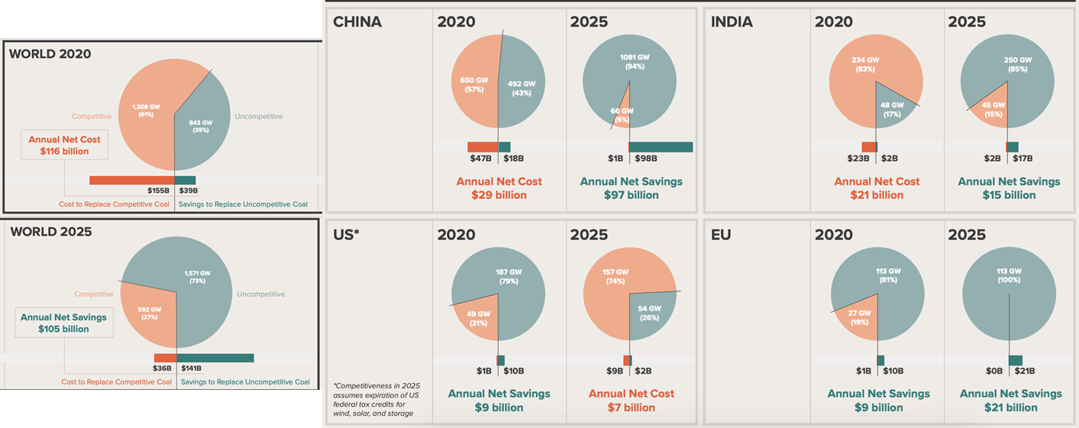
79% of US coal – and 39% of coal globally – can’t compete with renewables and storage today
Source: How to Retire Early, RMI, Carbon Tracker, Sierra Club

